Slide 1

The meeting will begin shortly
In the meantime, enjoy these cool tunes!

Slide 2



Introduction to
Our New HCM System
Notes:
Now UKG,
Kronos + UltiPro
Session recorded

Slide 3

Housekeeping Rules
Chat your questions in and we’ll answer them at the end.
Starred items indicate a training is available.
You are encouraged to follow along with your own account.
Stay tuned for a game/giveaway at the conclusion of our meeting.
Notes:
Chat Questions – Muted
Starred training materials – suggestions for more training materials
Follow along
Game at the end

Slide 4
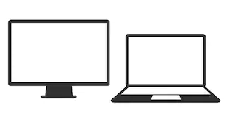



After the meeting Play Trivia Game to Win
Just need internet on your device
No registration required

Slide 5

Agenda
UKG System Walk-through
Time Management Training
Recap
Game

Slide 6
Using
What can I do in the new system?
View
01
View pay
Enroll
02
In your annual
Update
03
Manage
04
Enter
Time off requests
05
View
Reporting & Company Information
06
Statements/W2
information
Personal
benefits
/ Tax Withholding
ER Contacts/
dependents
Notes:
Replacing Paychex & PlanSource

Slide 7
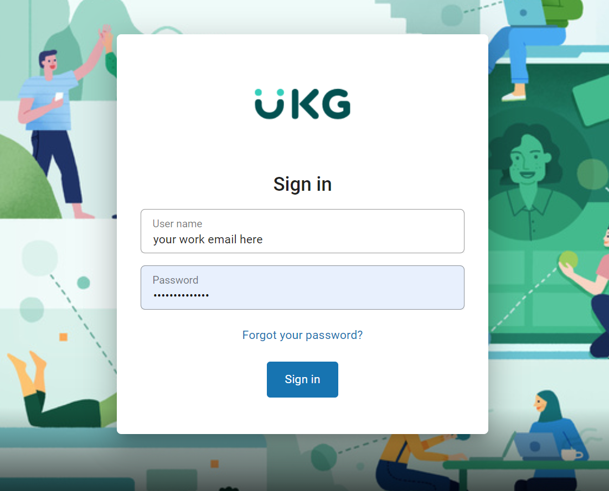
ACCOUNT SETUP: How do I log In?
Website:
  https://nw15.ultipro.com/
Username:
  Your work e-mail address
New Hire/ Reset Passwords:
  Birthday (MMDDYYYY format)
Existing Employees:
  What was set at Open Enrollment
You can also visit https://www.iapmohr.org >> UKG for a guide
Notes:
Site user specific
PW @ Open enrollment
New Hires , First time logging in – DB 2- YY 2-MM 4-YYYY

Slide 8
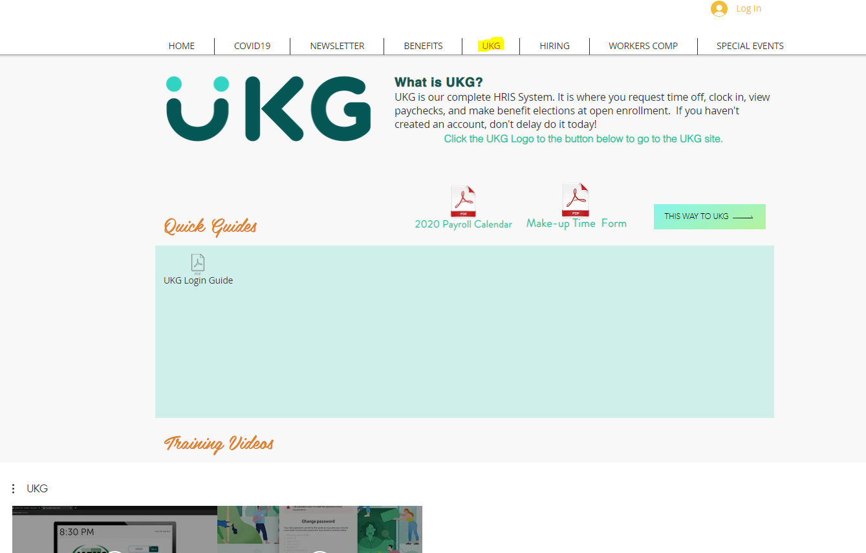
https://www.iapmohr.org
Notes:
Where can I find UKG Site?
Many have hr site bookmarked
Photo linked
Button link

Slide 9
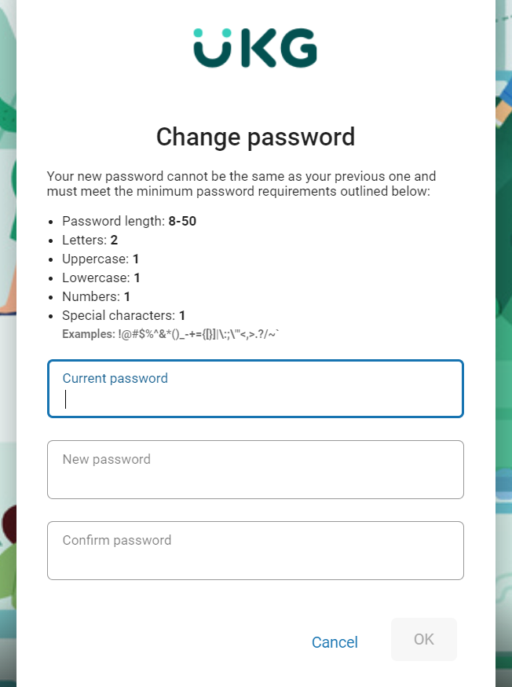
ACCOUNT SETUP:
Password Requirements
After logging in to the self-service for the first time with your BIRTHDAY (MMDDYYYY), you will be prompted to change your password.
For security reasons your password:
  Must contain at least one upper-case alphabetic character, one lower-case alphabetic character, one numeric character, and one special character
  Can be any combination of alpha-numeric characters that meet the above requirement
  Cannot include spaces or apostrophes
  Is case sensitive
Notes:
Prompt to change pw at first login

Slide 10
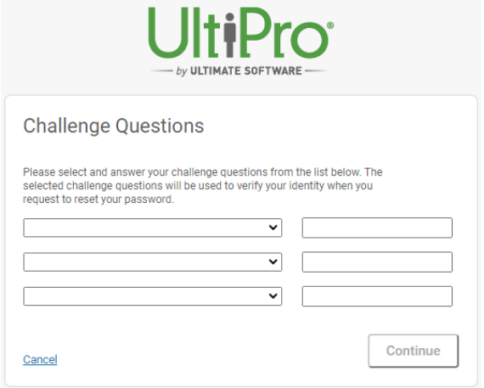
ACCOUNT SETUP:
Challenging Questions
You will be asked to setup three challenge questions which can be used to reset your password in case you forget it and click the Forgot your Password link.
Tips to setup the challenge questions:
Select questions that you the answer to and type in the answer below that question
The answers are case-sensitive
Remember your password!
NOTE: It is always best to record your username and passwords in a safe place for future reference. As HR will only be able to completely reset your account.
Notes:
We believe it might be case sensitive
Save your PW - New Hires/Password Resets

Slide 11
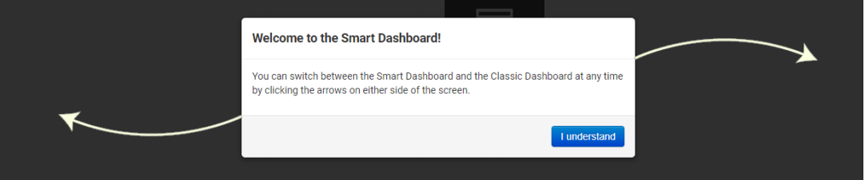
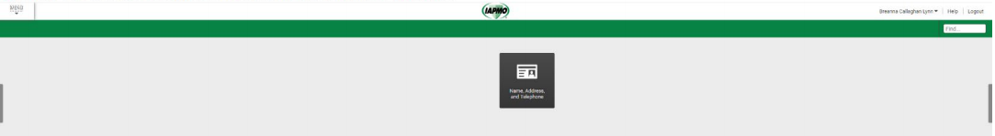
NAVIGATING YOUR ACCOUNT:
Self -Guided Tour
At initial log in, you will be asked to click the “I understand” button.
You will then be prompted to go through the self guided tour when you first log in.
Login Training Video available on UKG Page of the HR site under “trainings videos”
Notes:
Self guided tour
First star means there is a training video on how to login

Slide 12

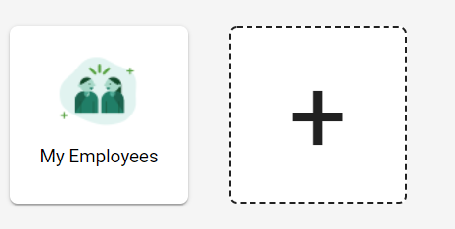
NAVIGATING YOUR ACCOUNT:
The Smart Dashboard – Adding Quick Links
On the left and the right of the screen you will see arrows, you can use these to toggle back and forth between
The Smart Dashboard and The Classic View.
You can personalize your Smart Dashboard by adding which Quick Links you would like to appear on your Smart Dashboard. The links that are available depends on your web access rights granted by your administrator.
To add a quick link, select the “+” on your Smart Dashboard, select the Quick Link you would like to add, and it will appear on your Dashboard.
Notes:
Once you’ve gone through the self guided tour you will see the dashboard
Toggle between smart dash and classic view
no widgets or quicklinks on classic view

Slide 13
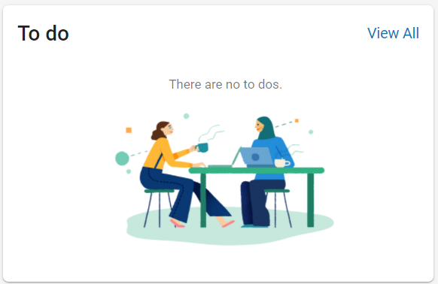
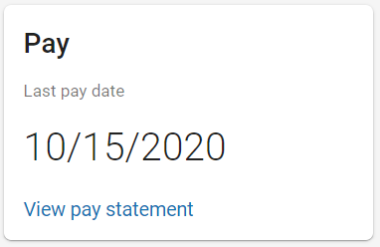
NAVIGATING YOUR ACCOUNT:
The Smart Dashboard – inbox & last pay widget
Also, on the home page you will see a widget to your last pay statement. This widget will link you to your very last pay stub.
The inbox will notify you of any action items that you might need to take, such as accepting new handbook, policies, or reading internal announcements
Notes:
Also on your dashboard you’ll find WIDGETS
More hopefully in development

Slide 14
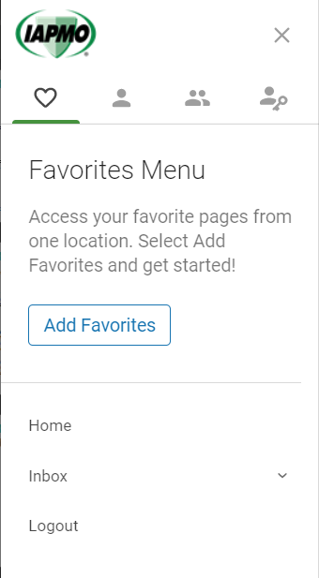

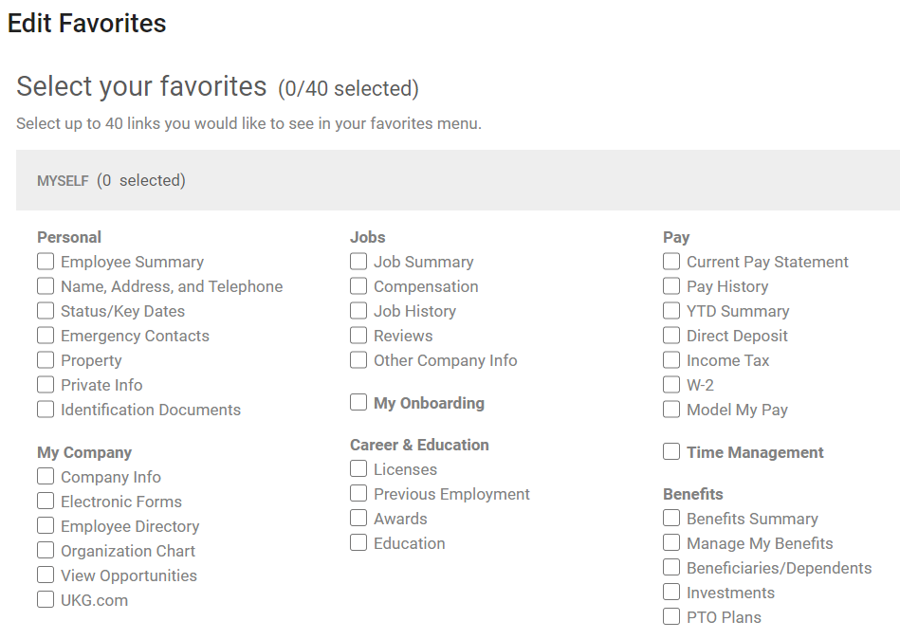
NAVIGATING YOUR ACCOUNT:
Favorites Menu
You can access your Favorites section by clicking on the heart you’ll find all the items that you’ve marked as your Favorites. This menu is customizable.
Notes:
Left Menu Pane >> Favorites Menu
Add Favorites
Select favorite quick links , save
Enable you to crate a menu to your liking

Slide 15
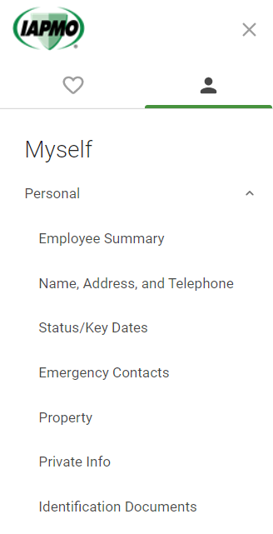
NAVIGATING YOUR ACCOUNT:
Personal
Employee Summary – This feature shows you personal demographic information, date of hire, job title, time in service, supervisor etc. Non-exempt – Time clock pin
Name, Address, and Telephone number – you can make edits to this Data. Does go to HR for approval.
Status/Key Dates – this shows you important dates such hire, rehire, retirement, etc.
Emergency contacts- can be added/updated here.
Property – in time IT and accounting will be able to provide your company property inventory such as equipment and credit cards.
Private Info – only visible to you, this is where your social, dob, i-9 and EEOC, disability and vet status.
Identification documents – can be housed here for new hires.
Notes:
Next to Favorite Menu is MYSELF
Myself opens host of options in categories of Personal, My Co, Jobs, Career & Education, Pay, Time Management, Time Clock, Benefits
Self explanatory
Quick overview of all
1st - PERSONAL
2 places to get your PIN
Before going onto My co.. Detour
Stars! – Name & Address, Emergency Contact

Slide 16
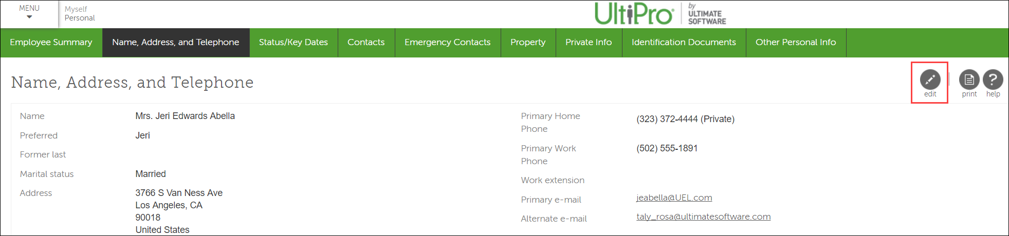
HOW TO: Update Personal Information
Personal >> Name,Address and Telephone
Personal information can be edited by clicking on the Edit button on the top-right corner of the Personal tab. Simply select the button and follow the instructions.
Note: Any information you have been given permission to change will display an “Edit” button at the top right. Simply select the button and follow the instructions.

Slide 17
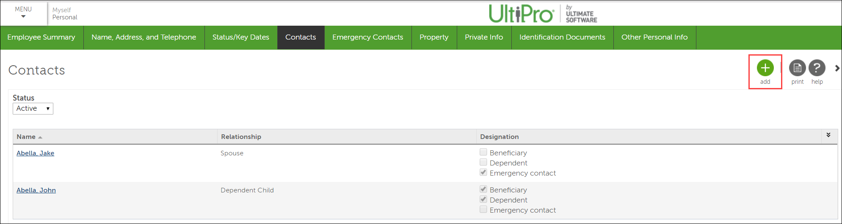
HOW TO: Manage Contact Information
Personal >> Emergency Contact
Select the + button on the Personal/Contacts screen to add a new contact.
Select the name of a current contact to update it.
Note: To add a person to a benefit such as medical or dental, you will need to use Life Events under Myself/Manage my Benefits/Life Event .

Slide 18
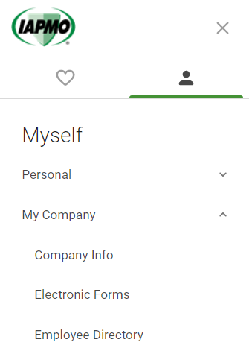
NAVIGATING YOUR ACCOUNT:
My Company
Company Info– is where you can see a broadcast of announcements to employees from HR.
Electronic Forms– Upload content or documents from your personnel file or anything you’d like to add to your digital file.
Employee Directory – beginning January 15 you will be able to search for US employees and their telephone numbers & email addresses. Global are projected end of Q2 in 2021.

Slide 19
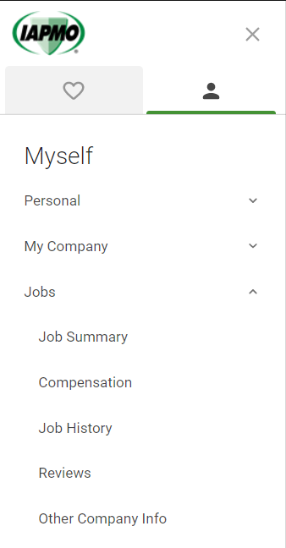
NAVIGATING YOUR ACCOUNT:
Jobs
Job Summary – is a quick summary of details of your role, and time of services. Note that this is where you will find the Time clock pin you will need to clock in if you’re nonexempt
Compensation– shows you the rate you are currently being compensated at in a yearly, semi, and hourly format.
Job History– will be a history of roles you’ve held in the organization.
Reviews - can be added/updated here.

Slide 20
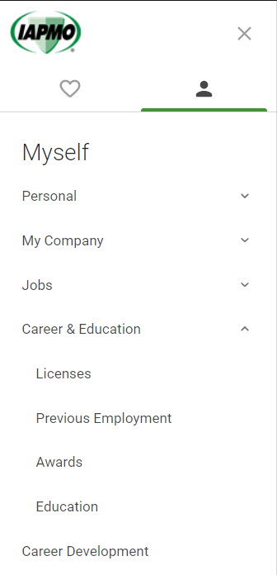
NAVIGATING YOUR ACCOUNT:
Career & Education
License– add your licenses and certificates and we’ll upload them here for you.
Previous Employment – add your previous employment here
Awards– add your awards and recognition and we’ll upload them here for you.
Education send us a copy of your degree and we’ll upload them here for you.

Slide 21
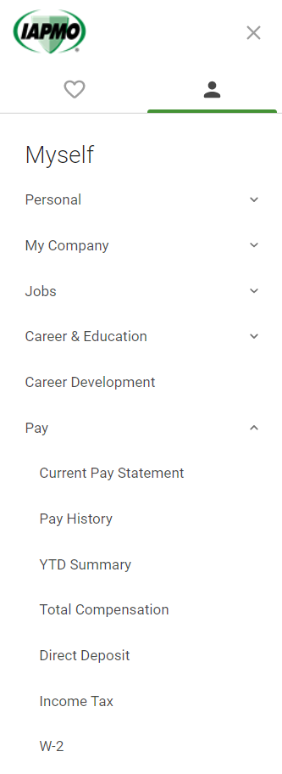
NAVIGATING YOUR ACCOUNT:
Pay
Current Pay Statement
Pay History– where pay statements will be saved beg. 1/15
YTD Summary – provides Year to Date totals on all pay/earning and deduction codes and taxes
Total Compensation – shows annualized totals of Non Work Earnings , Employer paid benefits and Employer paid taxes.
Direct Deposit – add/delete DD information
Income Tax– Federal and State deductions
W2

Slide 22
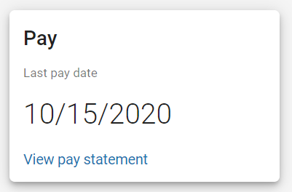
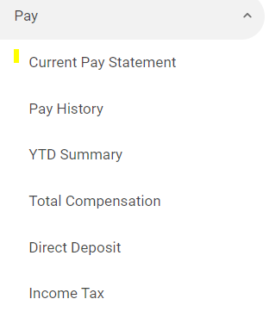

HOW TO: Pay Statement Information
Pay >> Current Pay Statement
Access your pay statements from the Home page or under Myself/Current Pay Statement.
Download or print your pay statements from the Statement screen.
1
2

Slide 23
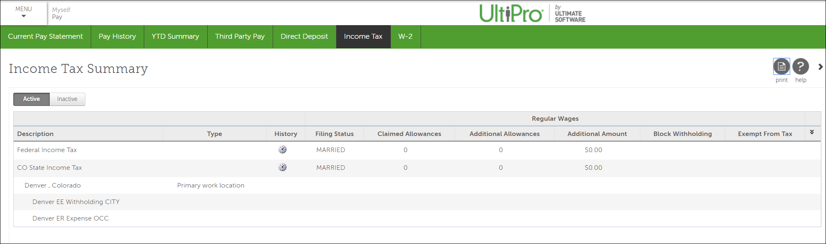
HOW TO: Check Withholdings
Pay >> Income Tax
View your tax exemptions, which will remain the same as they were on the 12/31 pay period in Paychex.
View your W-2s under Pay/W-2 whenever they are available.
  2020 – Paychex by 1/21/2021 – Paychex will be cancelled after then
  2021 – UltiPro

Slide 24
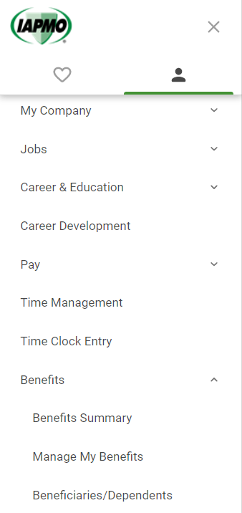
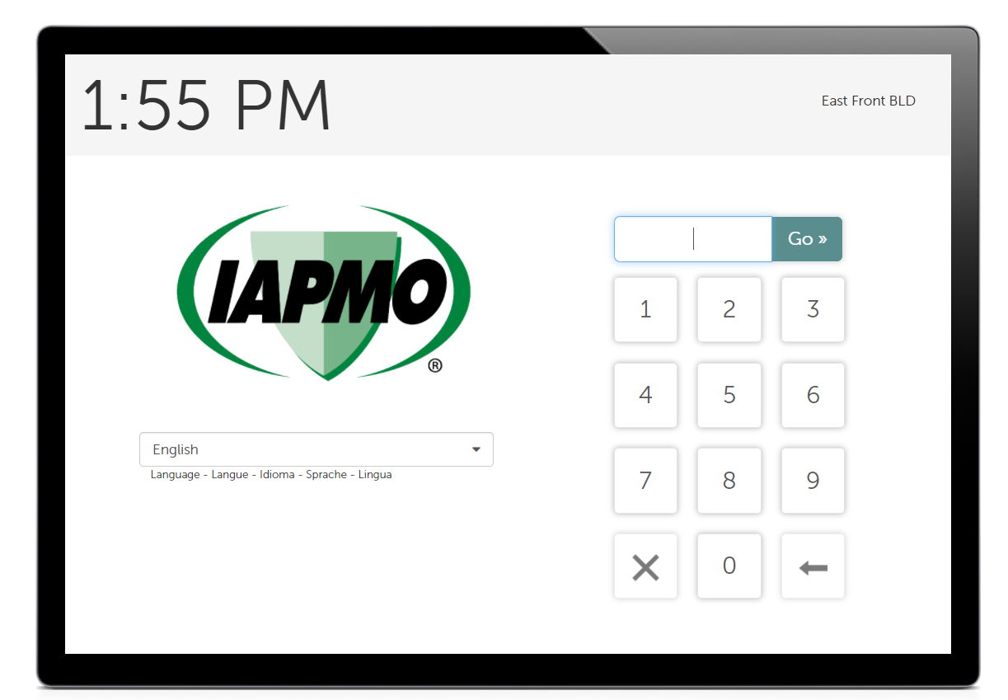
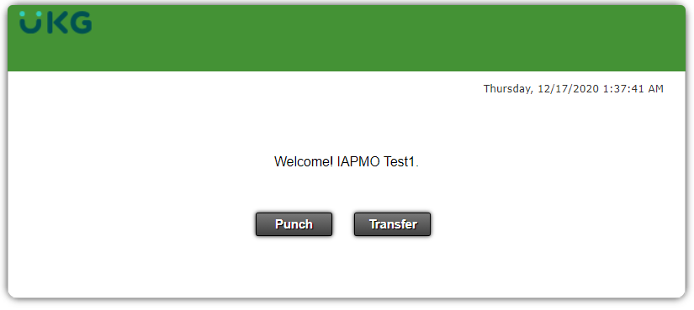
NAVIGATING YOUR ACCOUNT:
Time Management & Time Clock Entry
Time Clock Entry – There are two ways to clock in.
Time Management – A tour is available on the IAPMO HR website under the UKG Page
2
Through the iPad Kiosks that will be replacing the Paychex ones.
1
Through your online account under Myself >> Time Clock Entry
Time Clock Pin can be found under Personal>> Employee Summary & Job >> Job Summary

Slide 25
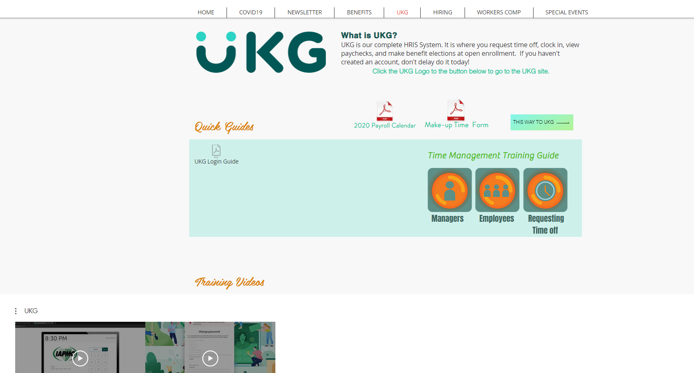
https://www.iapmohr.org
8:00
2:00

Slide 26
NAVIGATING YOUR ACCOUNT:
Benefits
Benefits Summary– see your current benefits deductions here
Manage My Benefits– you can make edits and they go to us for approval.

Slide 27


Reminders
Hours will be transferred over on 1/31/2021
Review all training materials on the HR website
W2’s – 2020 W2 is in Paychex | 2021 W2 in UKG
Your action items
Non-exempt begin clock in 12/29
ALL Time off request need to begin on 12/29 in UKG
Future time off dates in Paychex will not transfer into UKG. Be sure to enter them
Download all your pay statements and W2’s since 2017
Review all training materials on the HR website

Slide 28


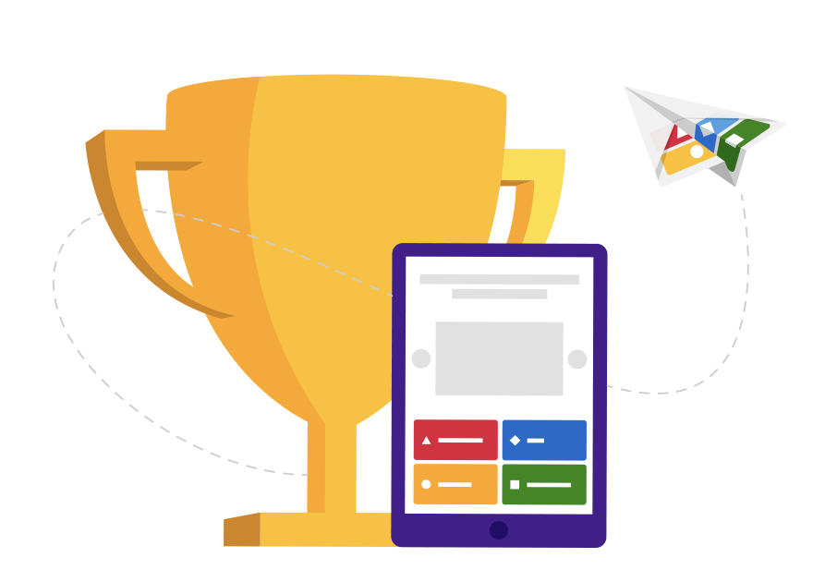
Questions
You will now be unmuted
We will read the chats but please raise your hand
Stay tuned
Game to follow

