Slide 1
Introduction to
Our New HCM System
Notes:
Now UKG,
Kronos + UltiPro
Session recorded

Slide 2
Housekeeping Rules
Chat your questions in and we’ll answer them at the end.
Starred items indicate a training is available.
You are encouraged to follow along with your own account.
Stay tuned for a game/giveaway at the conclusion of our meeting.
Notes:
Chat Questions – Muted
Starred training materials – suggestions for more training materials
Follow along
Game at the end

Slide 3
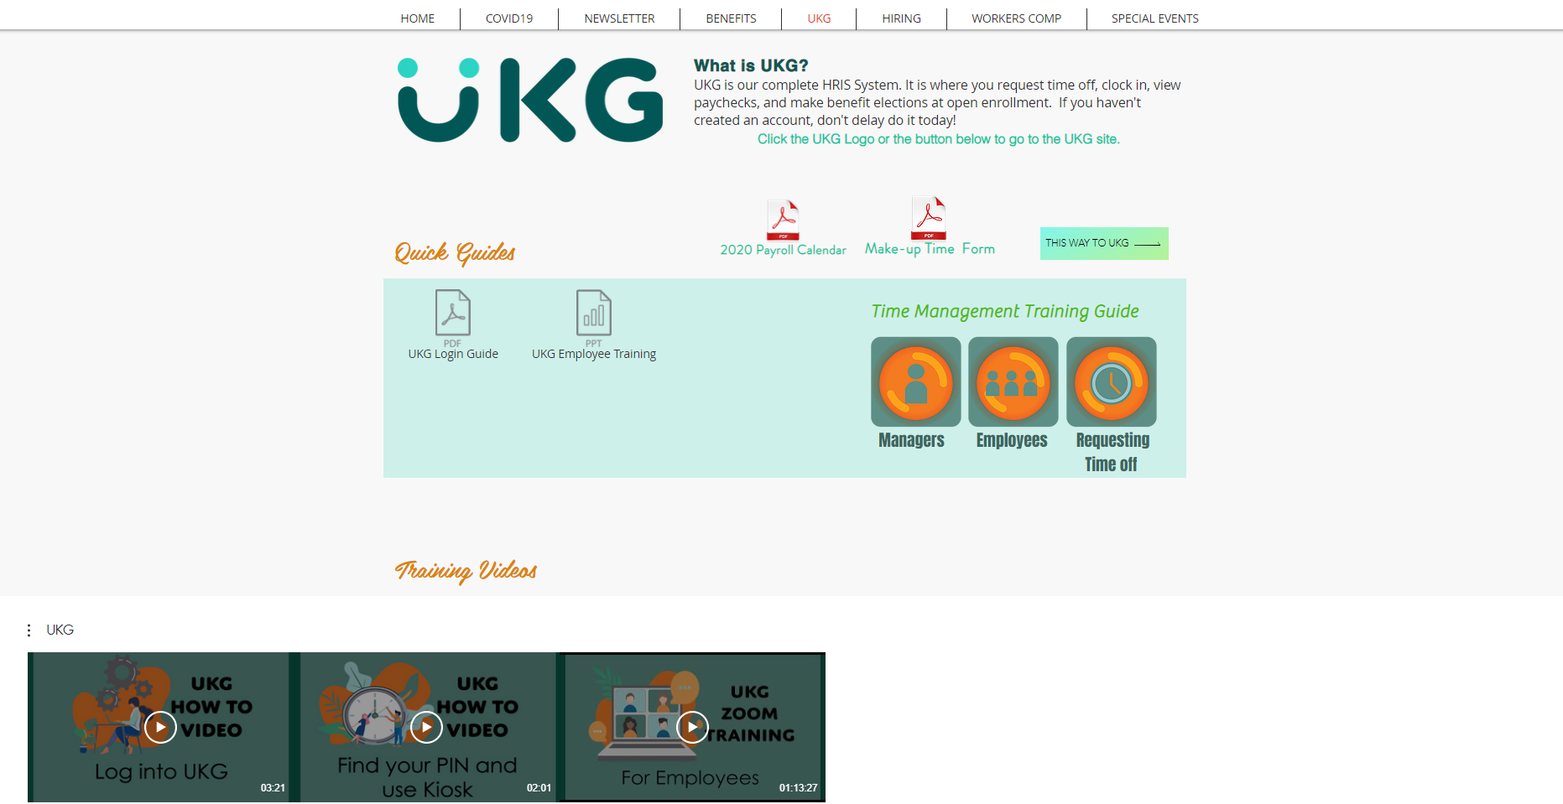
HTTPS://WWW.IAPMOHR.ORG

Slide 4
What will be covered
How to log in
Overview of My Team Menu
Accessing Time Management
Overview of the Time Management System
Review, Edit and Approve employee Timesheets
Respond to employee time-off requests
Overview of generating reports
Requesting and reviewing your own Time-Off Request

Slide 5
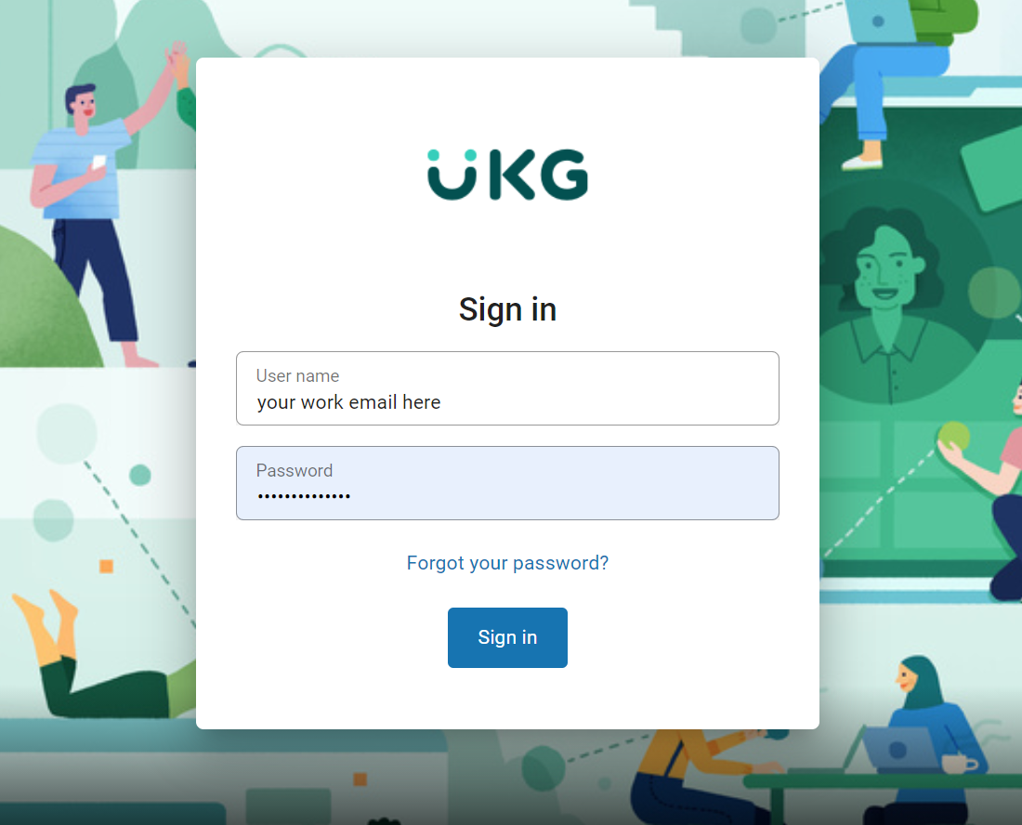
ACCOUNT SETUP: How do I log In?
Website:
https://nw15.ultipro.com/
Username:
Your work e-mail address
New Hire/ Reset Passwords:
Birthday (MMDDYYYY format)
Existing Employees:
What was set at Open Enrollment
You can also visit https://www.iapmohr.org >> UKG for a guide
Notes:
Site user specific
PW @ Open enrollment
New Hires , First time logging in – DB 2- YY 2-MM 4-YYYY

Slide 6
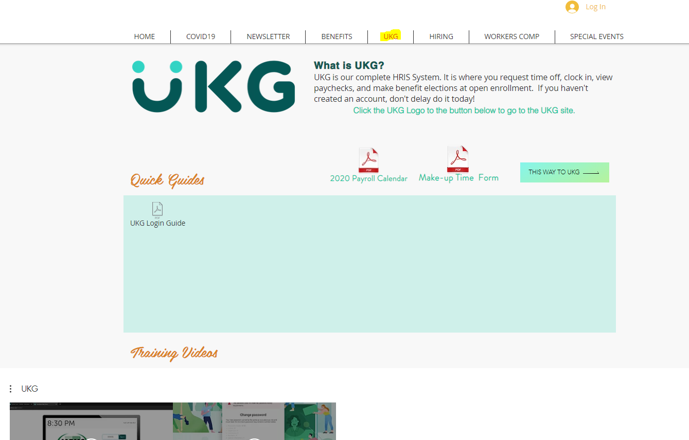
https://www.iapmohr.org
Notes:
Where can I find UKG Site?
Many have hr site bookmarked
Photo linked
Button link

Slide 7
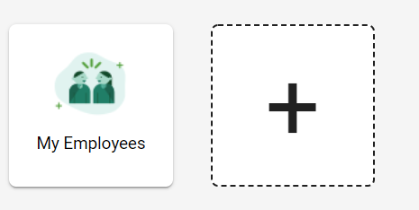
NAVIGATING YOUR ACCOUNT:
The Smart Dashboard – Adding Quick Links
On the left and the right of the screen you will see arrows, you can use these to toggle back and forth between
The Smart Dashboard and The Classic View.
You can personalize your Smart Dashboard by adding which Quick Links you would like to appear on your Smart Dashboard. The links that are available depends on your web access rights granted by your administrator.
To add a quick link, select the “+” on your Smart Dashboard, select the Quick Link you would like to add, and it will appear on your Dashboard.
Notes:
Once you’ve gone through the self guided tour you will see the dashboard
Toggle between smart dash and classic view
no widgets or quicklinks on classic view

Slide 8
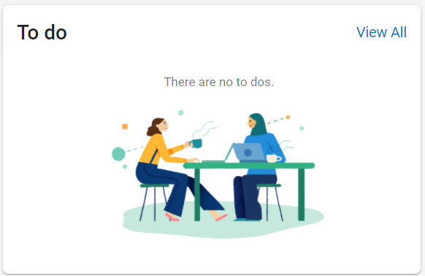
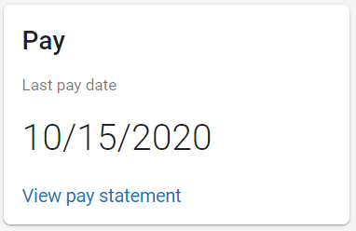
NAVIGATING YOUR ACCOUNT:
The Smart Dashboard – inbox & last pay widget
Also, on the home page you will see a widget to your last pay statement. This widget will link you to your very last pay stub.
The inbox will notify you of any action items that you might need to take, such as accepting new handbook, policies, or reading internal announcements
Notes:
Also on your dashboard you’ll find WIDGETS
More hopefully in development

Slide 9
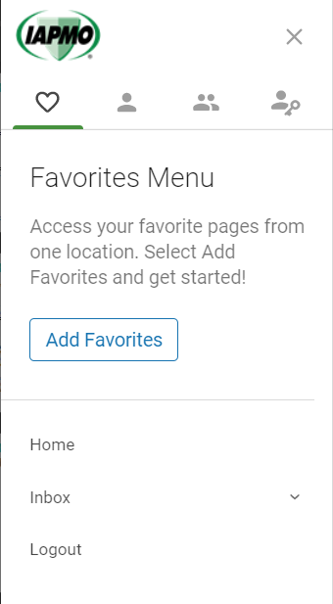
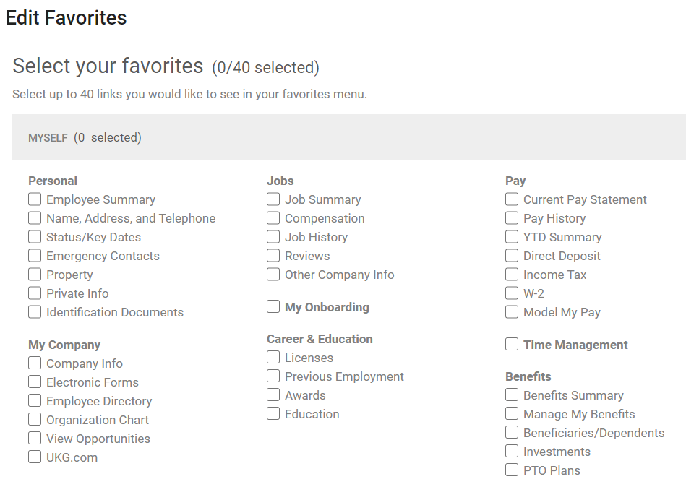
NAVIGATING YOUR ACCOUNT:
Favorites Menu
You can access your Favorites section by clicking on the heart you’ll find all the items that you’ve marked as your Favorites. This menu is customizable.
Notes:
Left Menu Pane >> Favorites Menu
Add Favorites
Select favorite quick links , save
Enable you to crate a menu to your liking

Slide 10
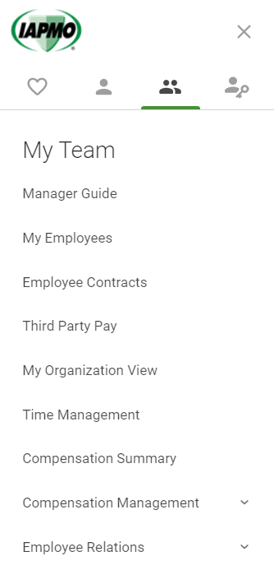
NAVIGATING YOUR ACCOUNT: My Team
Manager Guide – is where you can find manager specific training/guides.
My Employees– by clicking search you can view your entire team and their individual profiles.
Employee Contracts – If you have employees with contracts that you have access to view, you can see their information here.
Third Party Pay – will contain information for agency staff you have on staff.
My Organization View – is an org chart that covers your department
Time Management – is where you will go to review your teams time off requests, timecards and time balances.
Compensation Summary – by clicking search shows you your team’s salary downloadable on a spreadsheet.
Compensation Management >> Salary Planning – allows you to view a developed Salary Plan
Employee Relations >> Disciplinary Actions – is where you can track current relations concerns.
Notes:
Next to Favorite Menu is MYSELF
Myself opens host of options in categories of Personal, My Co, Jobs, Career & Education, Pay, Time Management, Time Clock, Benefits
Self explanatory
Quick overview of all
1st - PERSONAL
2 places to get your PIN
Before going onto My co.. Detour
Stars! – Name & Address, Emergency Contact

Slide 11
HTTPS://WWW.IAPMOHR.ORG

Slide 12
Time Management for Time Approvers

Slide 13
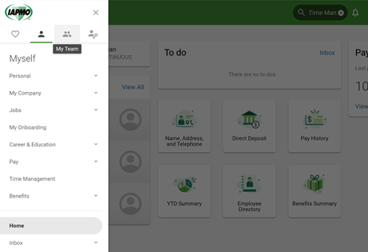
ACCESSING TIME MANAGEMENT:
For Yourself & Your Employees
Supervisors can access Time Management functions from the side navigation menu or from the Find field from the home page.
The one-person icon is for yourself and the two people icon is for access to your team

Slide 14
What are the Different Categories within Time Management?
Attendance: Used to review, edit and approve employee timesheets, review accrual and attendance history, and monitor who is at work and who is away.
Scheduler: Used to review and respond to employee time-off requests
Reports: Used to generate reports that can be tailored to your reporting needs.
Preferences: Used to select your preferred information display options and how you want time-off request alerts to display
Dashboard: Used to present relevant information that can track on a single page

Slide 15
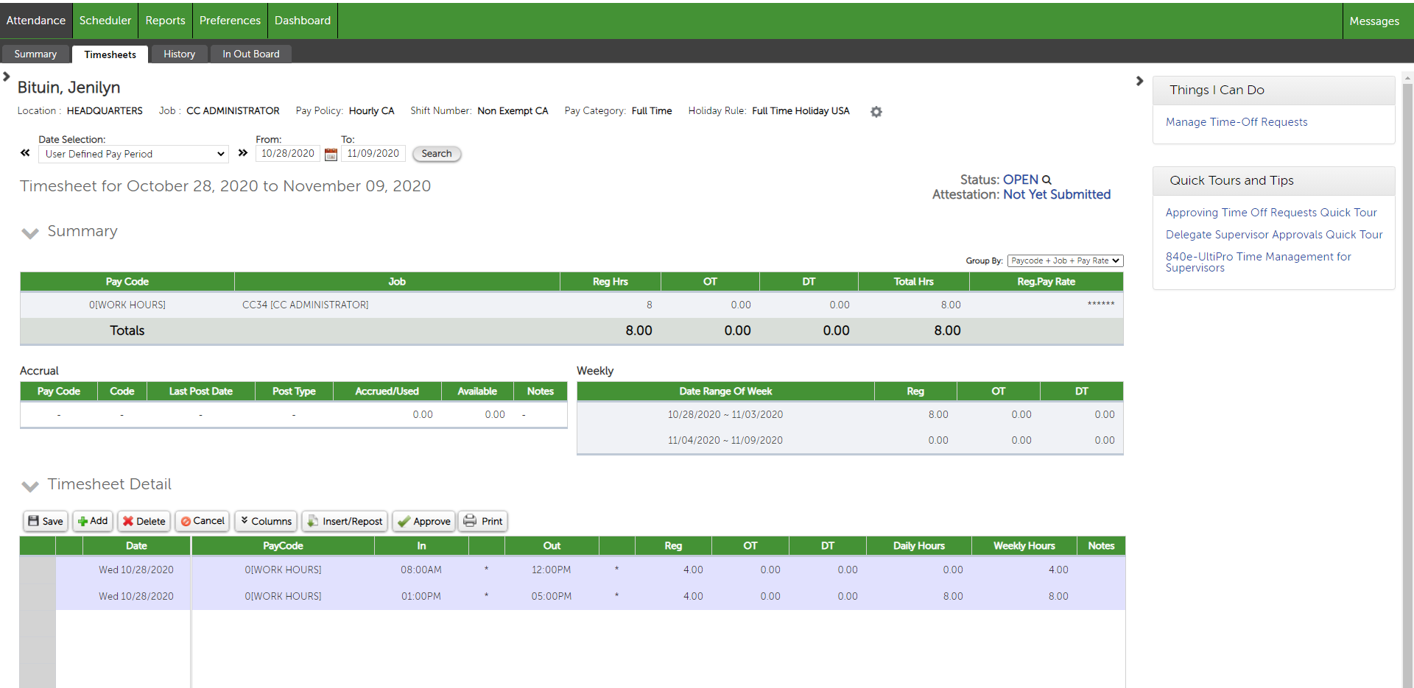
Accessing Employee Timesheets The Timesheets tab can be found under the Attendance category. This is where you will also find summarized information regarding employee accruals, weekly time, date range selections, manage time off requests, and other employee information

Slide 16
Adding or Correcting a Timesheet Punch
You can change to the correct time directly on the timesheet.
Choose what time needs to be corrected and click on Save. Please note the IN or OUT punch is also used for lunch hours.
A missing punch will show up red on a timesheet. You may add to a missing punch by keying it into the IN or OUT column of the timesheet
Note: Times entered without an “am” or “pm” designation are assumed to be “am” times.

Slide 17
Adding Non-Work Time to Timesheets
It is recommended the employees request any PTO time. But if you need to add non-worked time, such as vacation or sick, the number is entered on the timesheets rather than IN and OUT times.

Slide 18
Approving Employee Timesheets
The Attendance Summary page can be used to approve timesheets as a group
You can also individually approve their timesheets individually under the Timesheet Detail
OR

Slide 19
Responding to Employee Time-Off Requests
You can find employee time off requests under the Scheduler tab and to the right of the timesheets tab. An option is also available to email the approved request to yourself and it will give you the option of saving to your Outlook.
When approving a request, a confirmation appears indicating that approved requests will post hours to the timesheet.

Slide 20
Report Generator Overview
The Report Generator page displays a list of published or saved reports and report templates that may help you keep track of your employees’ time and attendance, management and others. These can also be tailored to you specific needs and can be filtered by employee and dates. Some reports included are:
Employee Timecard: Displays individual timecards that include details on a specific employee and date range
Monthly Attendance Summary: Displays a summary of employee attendance records for a selected month.
Request Time-Off Report: The report displays employee time-off requests that were submitted during selected date range. This includes the pay code, date/time of request, date of time-off, hours requested, status, approval details, and more.
Approaching Overtime Report: The report displays a summary of hours and pay for employees who meet or exceed the selected threshold value. This can include regular hours, overtime hours, unauthorized overtime hours, total hours, number of hours over the threshold value, average pay, and pay over the threshold.

Slide 21
How to Request Time and Review Your Own Time-Off
Step 1: From the home menu, select the one-person icon to Time Management.
Step 2: Under the Attendance tab, you will find your timesheet area. To the right under “Things I Can Do”, you can add a time off request
Step 3: Select the type of request the dates
You can review your time off requests under the scheduler tab.

Slide 22
Reminders
Hours for you and your team will be transferred over on 1/31/2021
Review all training materials on the HR website
Encourage your employees to get their Paychex data soon
Your action items
Ensure your non-exempt begin clocking in 12/29
Ensure you and your team submit all time off request need to begin on 12/29 in UKG. Please note if they’ve entered future time off in Paychex, they’ll need to enter that information in UKG.
Download all your pay statements and W2’s since 2017
Review all training materials on the HR website

